Slide 1

Evaluation-I
MEP023U3M: Machine Design Lab
Presented by
Kshitij Gera (2020ume0207)
30 January 2023

Slide 2

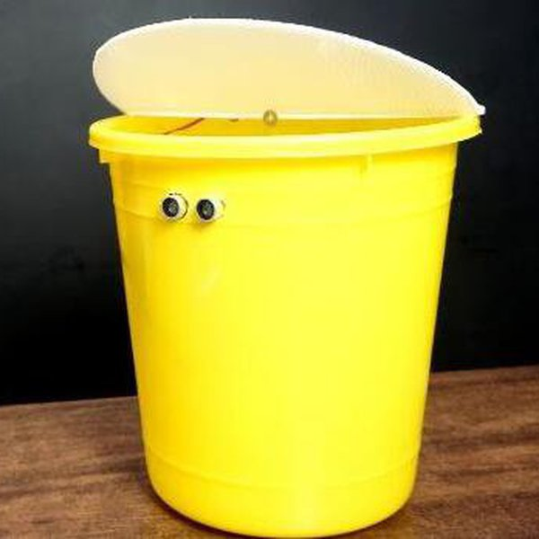
Introduction
Smart DustBin
The problem of proper waste management and segregation is becoming increasingly important, as waste generation increases. A solution to this problem is a smart dustbin that uses object detection to automatically sort waste materials into appropriate compartments based on their recyclability. This technology reduces the workload of waste management workers and ensures proper disposal and recycling of waste, making a positive impact on the environment. The objective of this project is to design such a smart dustbin to improve waste management efficiency and effectiveness.

Slide 3
Identification of Need
Environmental protection: Proper segregation of waste helps reduce the amount of waste that ends up in landfills, reduces pollution, and protects the environment.
Resource recovery: Segregating recyclable waste makes it easier to recover valuable materials that can be reused in the production of new products.
Cost savings: By reducing the amount of waste sent to landfills, cities and communities can save on waste management costs.

Slide 4
Identification of Need
Increased efficiency: A smart dustbin can automate the process of waste segregation, reducing manual labor and increasing efficiency.
Data-driven decision making: By collecting data on waste generation and segregation, cities and communities can make informed decisions about waste management practices.
Better public health: Proper segregation of waste helps reduce the spread of diseases and improve public health by reducing the exposure of people to waste.
Smart dustbins can play a crucial role in reducing waste and promoting sustainable waste management practices.

Slide 5
Problem Definition
Waste management and segregation
Smart Dustbins which are present in market do not segregate wastes.
The dustbin will be equipped with cameras and sensors that can detect the type of waste material being thrown into it and sort it into different compartments based on its recyclability.
The number of categories for segregation can be increased.
This device will convert a dustbin which is not smart to a smart dustbin. (depends on the shape of dustbin).
This device can also provide a lot of data for waste management.

Slide 6
Problem Definition
In addition to object detection, the smart dustbin should also be equipped with a user interface for easy operation and maintenance. The user interface should allow for easy customization of the waste categories and the associated sorting rules. It should also provide real-time data and analytics on the waste collected, including the volume and composition of the waste.
In conclusion, the development of a smart dustbin that uses object detection to segregate waste can significantly improve the efficiency and effectiveness of waste management systems. It can reduce the workload of waste management workers and ensure proper disposal and recycling of waste materials. By utilizing the latest advancements in computer vision and machine learning technologies, this project has the potential to make a significant impact on the global waste management industry.

Slide 7
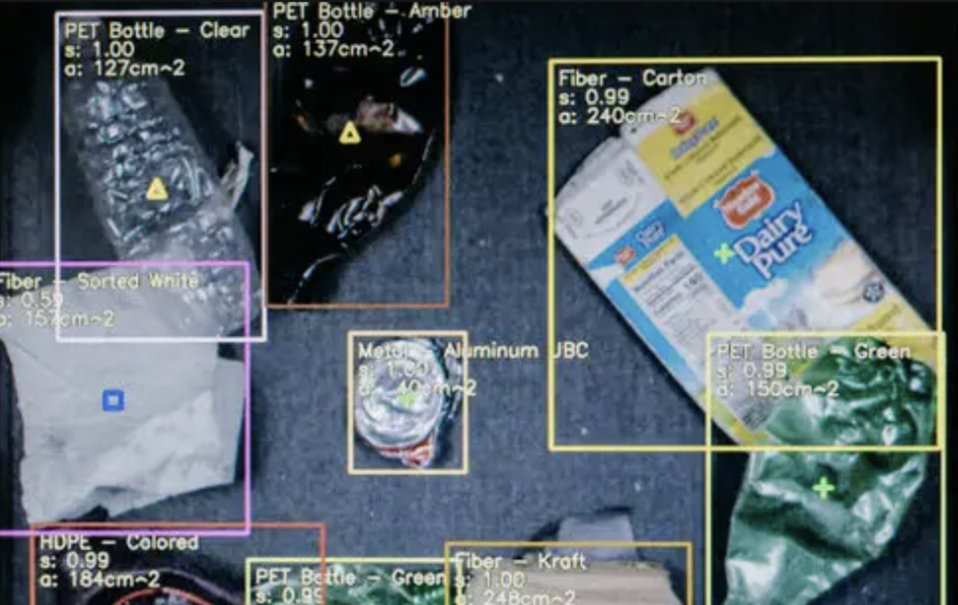
Synthesis
Three compartments : recyclable, non recyclable and miscellaneous
Sorting Mechanism
Flow process
Rough visualization

Slide 8
Synthesis
Components:
Tray:
It will be responsible for moving the waste to the correct bin after the classification is done via image processing.
Conveyer belt:
Waste will move through the sorting mechanism by a conveyor belt.
Camera:
Camera will be placed above conveyer belt, it will detect the boundaries and type of a waste.
Barricades :
At the end of conveyor belt, different barricades will be placed , barricades will allow only a single object to pass at a time.
Two types of barricades:
1: To sort things placed on top of each other.
2: To sort things placed parallely (horizontal) (using camera).

Slide 9
Synthesis
Flow process :
Waste will be placed on the plate
It will move down to the separate compartment where the dust, sand and grain like particles will flow down through mesh. Here will also tear the bags using blades.
Afterwards it will move up and move on conveyor belt.
Here we will have the vertical barricade which will separate objects based on the height i.e. placed on top of each other.
Then the camera will analyze the periphery, and will use another set of barricades made up of cylindrical objects which will move based on the periphery and will allow only one object to fall on the tray.
Lastly tray will transfer the waste to particular compartment (based on the waste type).

Slide 10
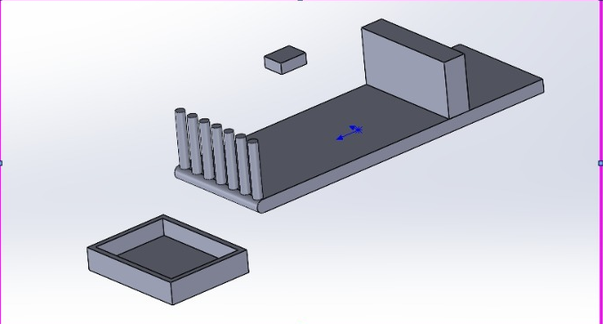
Synthesis1

Slide 11
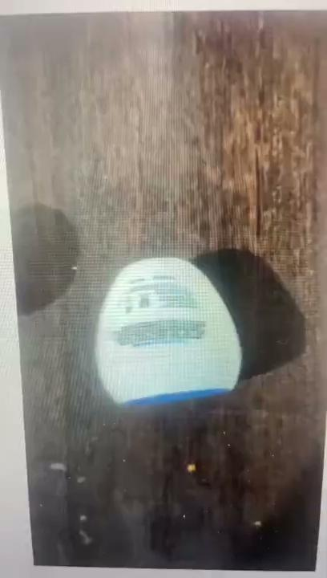
Image processing
Used yolov8
Classification of cups and not cups

Slide 12
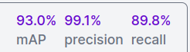
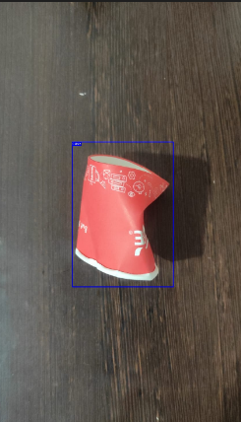
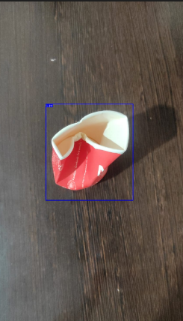
Demo

Slide 13
Connections
Using arduino as controller
Operation of servos and stepper motors using arduino
Servo motors to produce linear movement
Stepper motor to produce rotational motion, for selecting the correct class and to move conveyor belt.

Slide 14
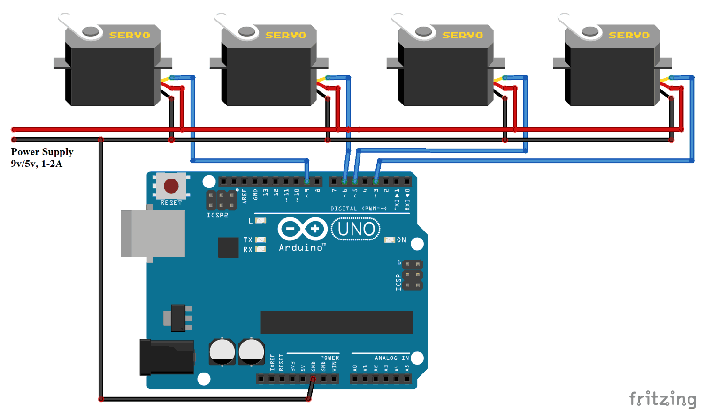
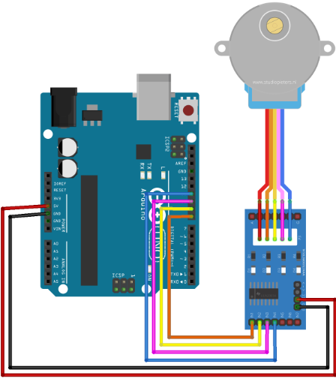
Connections

Slide 15
Final Model
Less Complex
Detection of paper cups only
Ultrasonic sensor to measure distance of the waste
Camera to classify the waste
Stepper motor rotates based on classification done by model on image

